Slide 1
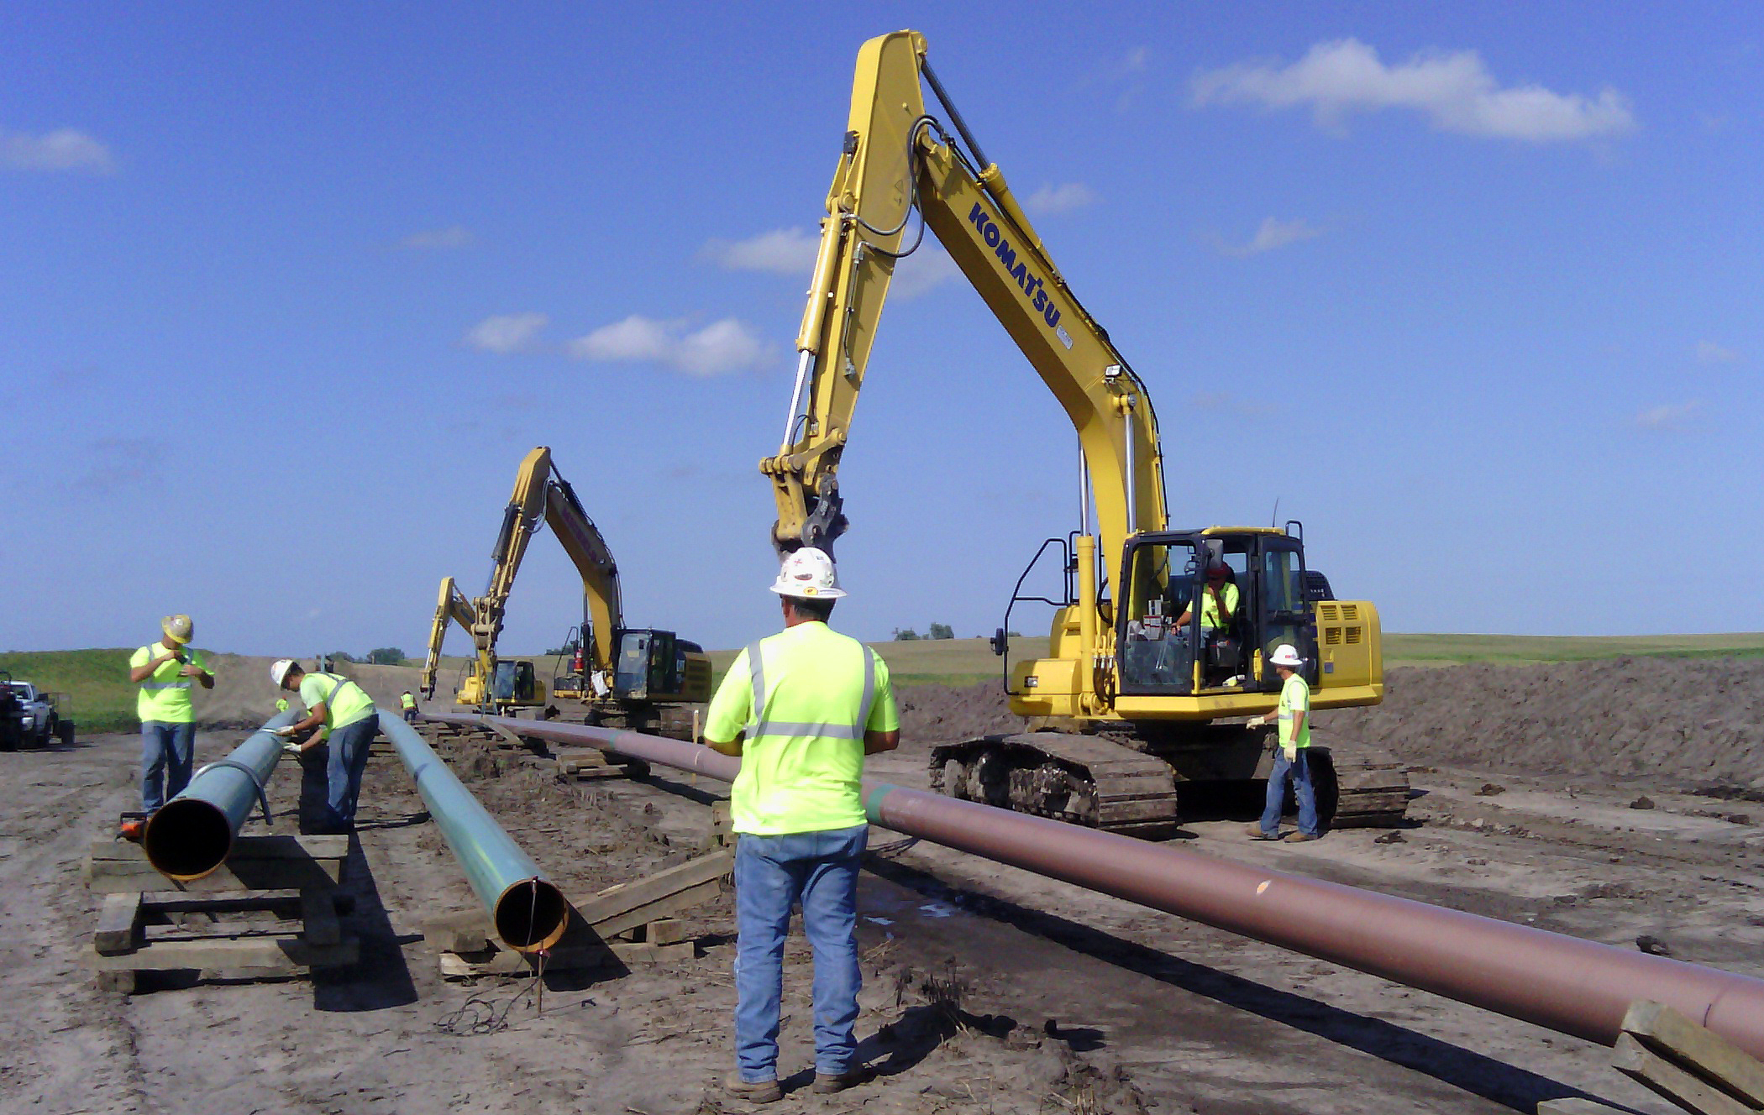
County’s Role in the IUC Pipeline Permit Process

Slide 2
Pipeline Permitting Process
Pipeline Company Begins Easement Negotiations
Informational Meeting
General sequence of events in the IUC’s Pipeline Permitting Process
If Approved, IUC Issues Permit
Hearing
Pipeline Company Files Petition for Pipeline Permit
Pipeline Construction Begins; Filing of Construction Reports Begins
Pipeline Construction Complete; Filing of Construction Reports Ends
Company Files As-built Map and Test Records

Slide 3
Designating County Inspector
Pipeline company will send notice of request for informational meeting to county board of supervisors of each affected county and a request for the board of supervisors to appoint a county inspector. The county inspector may be present at the informational meeting.
The board of supervisors designates a county inspector for each project after receiving pipeline company’s notice of the intent to build the pipeline. The county inspector can be the county engineer or an independent licensed professional engineer.
If the proposed pipeline project affects several counties, the board of supervisors of each county can work together and hire one county inspector for the entire project.
If the county inspector changes, the board of supervisors notifies the pipeline company, which file the updated information with the IUC.
All reasonable costs of inspection are borne by the pipeline company.

Slide 4
Reporting Templates
Successful inspection programs will include detailed reporting standards and consistent document organization practices, all of which can be contained within reporting templates and inspection procedures developed prior to construction.
Reporting templates should include, but are not limited to the following information:
IUC docket number
Report ID number
Project number
County inspector name
Date of inspection
County
Specific tract number
Weather and soil conditions
Documented communication (any interaction with landowners)
County inspector’s signature
Detailed records of all work performed throughout the day. (IUC recommends a separate report be completed for each permanent tile repair.)
Non-conformance work
Deviations in work due to landowner agreement
Photos reflecting what is included in the report with a description and location of where the photo was taken

Slide 5
Document Organization
The suggested method for organizing county inspector reports electronically during the project is to:
Create a folder for each tract along the project to store all pertinent reports
Create sub-folders within each tract folder to collect specific inspection/report types
Save documents using a consistent naming convention comprised of some combination of the following:
Date Created
Tract
Report ID Number
Type of Report

Slide 6
Pipeline Project Sequence
Request for Informational Meeting Sent to County Board of Supervisors
County Board of Supervisors May Appoint a County Inspector
Informational Meeting Held
Topsoil Removal and Stockpiling
IUC Permitting Process
Project activities that will require inspection by the county inspector
Boring
Clearing
Right-of-Way Staking
Trenching
Tile Marking, Screening,
and Temporary Repair
Permanent Tile Repair
Restoration and Revegetation
Clean-up
Decompaction
Backfilling
Pipeline Testing (may be conducted after backfilling)
Document Submittals

Slide 7
County Inspectors (before construction)
Before construction begins, the county inspector should obtain the following information from the pipeline company:
Alignment Sheets containing tract information, project route, and right-of-way limits
Project Specifications and Procedural Manuals
List of affected persons
Independent Landowner Agreements already obtained
Topsoil survey depths results
Available tile maps received from landowners
Pipeline company’s contact information or pipeline company’s contractor’s contact information
The county inspector should provide a list of county inspector personnel and their contact information to the pipeline company, the pipeline company’s contractors, and the county board of supervisors.

Slide 8
County Inspectors (during construction)
Organization and Communication
County inspectors will generate a significant number of reports. Having a detailed plan for organization and storage of these reports is critical to ensuring the success of the inspection program and accurate communication of the reports to the board of supervisors.
Open communication between the county inspector and the board of supervisors, in the form of ongoing status reports and updates, can help keep the board of supervisors informed of the work being done and any potential issues as they arise.

Slide 9
County Inspectors (during construction)
Notice of Violation Process
If there are violations of the standards adopted by the state, land restoration plan, or independent agreements, the county inspector will follow the Notice of Violation process by first contacting the pipeline company and contractor.
If the violation is corrected, construction may continue.
If the violation is not corrected, the county inspector will issue a Stop Work Order, applicable only to the activity and location of the violation.
If the pipeline company does not remedy the violation in accordance with the Stop Work Order, the county inspector will provide the board of supervisors with written notice of the violation that includes:
Location of the violation
Explanation of the violation
Time frame of the violation
Original written Notice of Violation provided to the pipeline company

Slide 10
Board of Supervisors - Notice of Violation Process
After receiving written Notice of Violation from the county inspector, the board of supervisors will decide whether to proceed with the Notice of Violation.
If the board of supervisors decides to move forward with the Notice of Violation, they may either address the violation or file a petition with the IUC for an order requiring corrective action to be taken on the violation in accordance with Iowa Code sections 479.29(5) or 479B.20(5).
If the board of supervisors decides not to move forward with the Notice of Violation, the county inspector should:
Provide the applicable landowner with original written Notice of Violation
Notify the pipeline company that the landowner has been informed
Include the violation on the inspector’s restoration punch list
It is recommended that the board of supervisors not consider the construction complete until each violation has been fully remediated or a signed agreement between the landowner and the pipeline company has been provided to the county inspector.

Slide 11
Completion of Projects
The county inspector gives a recommendation when final restoration has been completed and vegetation across the project has reached 70% of its growth.
The board of supervisors determines when construction of a pipeline has been completed in that county.
After the board of supervisors officially closes the project, the county inspector finalizes all project documentation in preparation for turnover. Document turnover includes all:
Inspection Reports
Tile Reports and Maps
Punch Lists
Stop Work Orders
Notice of Violation Documents
Special Landowner Agreements

Slide 12
Request For Damages
The statute provides that 90 days after the board of supervisors determines construction is complete, a landowner may request a compensation commission be appointed to determine damages from construction when the landowner and the pipeline company have not been able to reach agreement.
If the board of supervisors approves the petition, the landowner or pipeline company may begin the proceeding by filing an application with the chief judge to appoint a compensation commission.
The remainder of the process is set out in Iowa Code 479.46 and 479B.30.

Slide 13
Questions?
For more information contact:
Iowa Utilities Commission 1375 E. Court Ave. Des Moines, IA 50319
Call - 515-725-7200
Email - iuc@iuc.iowa.gov
Online - iuc.iowa.gov
or iuc@iuc.iowa.gov
site: iuc.iowa.gov

